Slide 1
The New B-Fabric
A Step Forward in Integrated Management of Life Sciences Projects and Data
C. Türker, F. Akal, C. Panse, H. Rehrauer, R. Schlapbach
Functional Genomics Center Zurich, Switzerland

Slide 2
Content
09:00-09:45 B-Fabric: Motivation, History, Overview (Ralph Schlapbach, Can Türker)
09:45-10:30 Managing Users, Projects, Orders with B-Fabric (Can Türker, Fuat Akal)
10:30-11:00 Break
11:00-11:45 Analyzing Data with B-Fabric (Hubert Rehrauer, Christian Panse)
11:45-12:15 B-Fabric for Switzerland (Fuat Akal)
12:15-12:30 Wrap-Up and Outlook (Can Türker)
12:30-14:00 Apero

Slide 3
B-Fabric
Motivation, History, Overview
Ralph Schlapbach, Can Türker
Functional Genomics Center Zurich, Switzerland

Slide 4
Why Functional Genomics ?

Slide 5





Notes:
Single analysis points
Few analysis points
Undersampling
Lack of reproducibility
Full picture building

Slide 6


Slide 7
Challenges in Functional Genomics
Challenges in the analysis of biomolecules
Biophysical and chemical properties of the molecules including number and diversity of the molecules incl. chemical modifications
Need for quantitation of identified molecules with low abundance of critical factors
Challenges in the understanding of biological systems
Complexity, temporal, and spacial dynamics of biological structures, signals, networks, pathways, etc.
Interdependence of events and molecules
Technical challenges for the processing and interpretation of data
Amount and complexity of data
Knowledge of inherent information vs. noise
Quality and sustainability of tools and methods

Slide 8
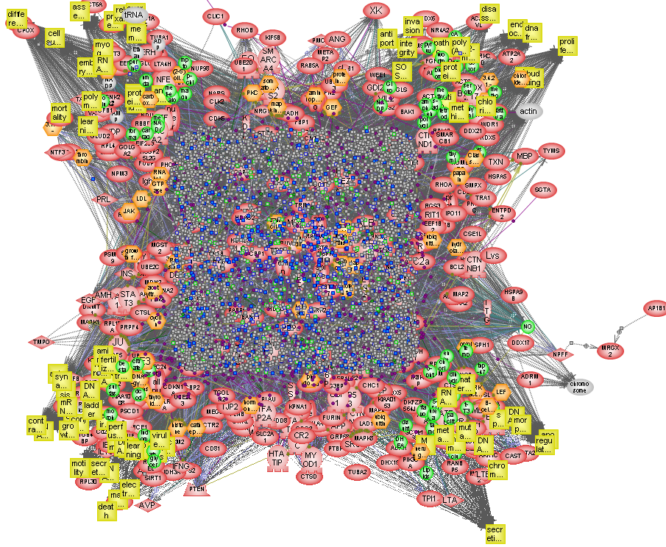
How (much) Functional Genomics ?
Regulated Genes and Proteins in Cancer Mismatch Repair

Slide 9
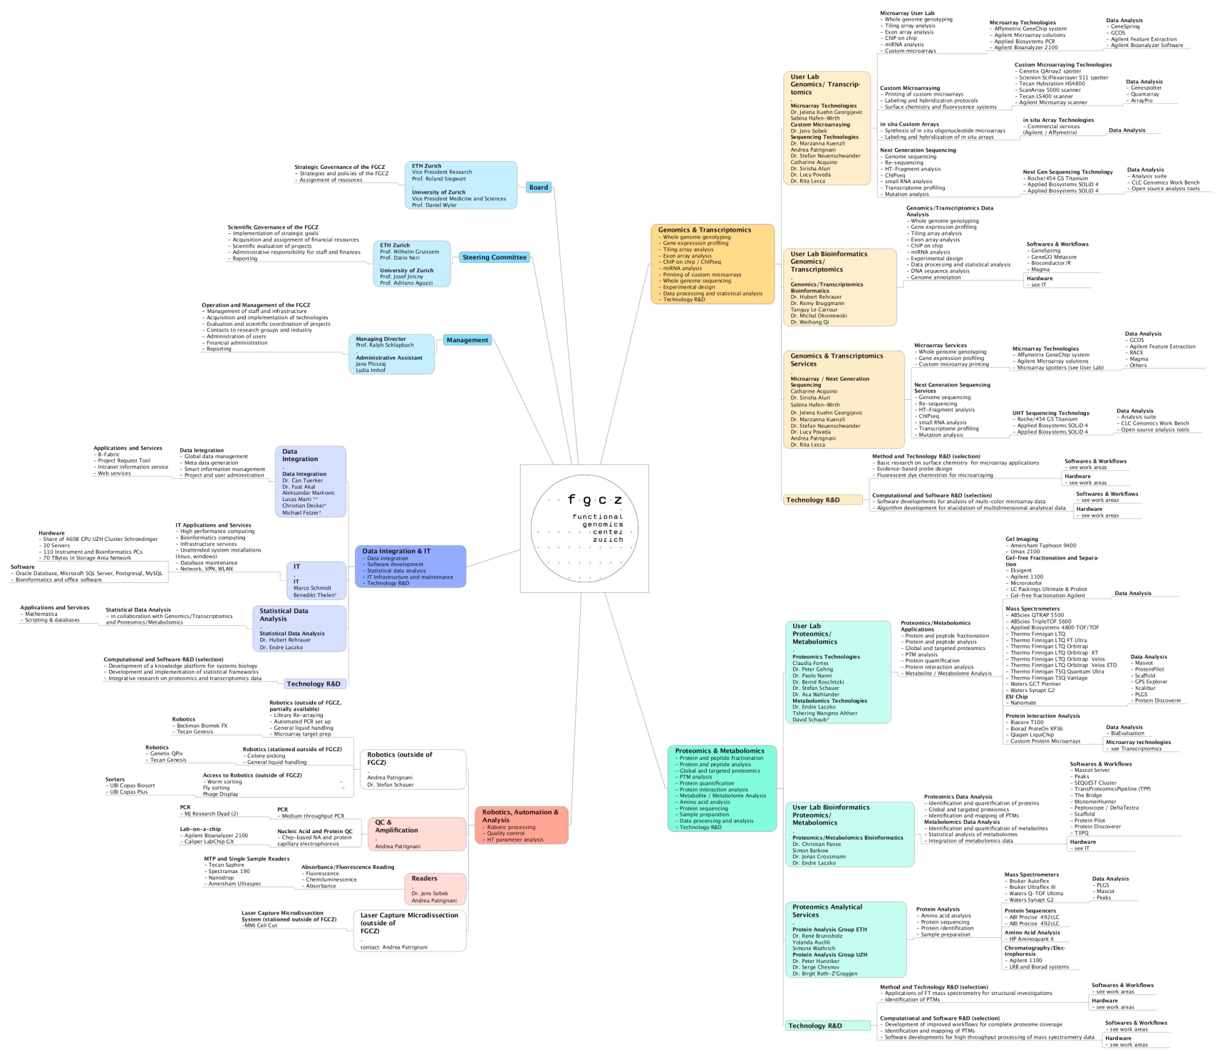
How (much) FGCZ ?

Slide 10
How much, how many ?
 | 31.12.02 | 31.12.11
Staff | 6 | 46
Users | <100 | >2000
Running Projects | 28 | 526
(Large) Instruments | 17 | 96
Institutions | 3 | 97

Slide 11
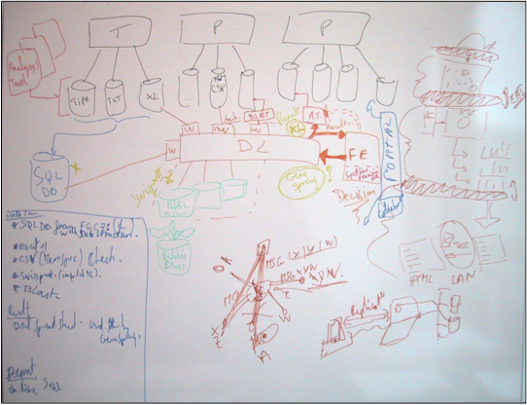
Why B-Fabric ?

Slide 12
In theory, there is no difference between theory and practice. In practice, there is.
Jan L. A. van de Snepscheut

Slide 13
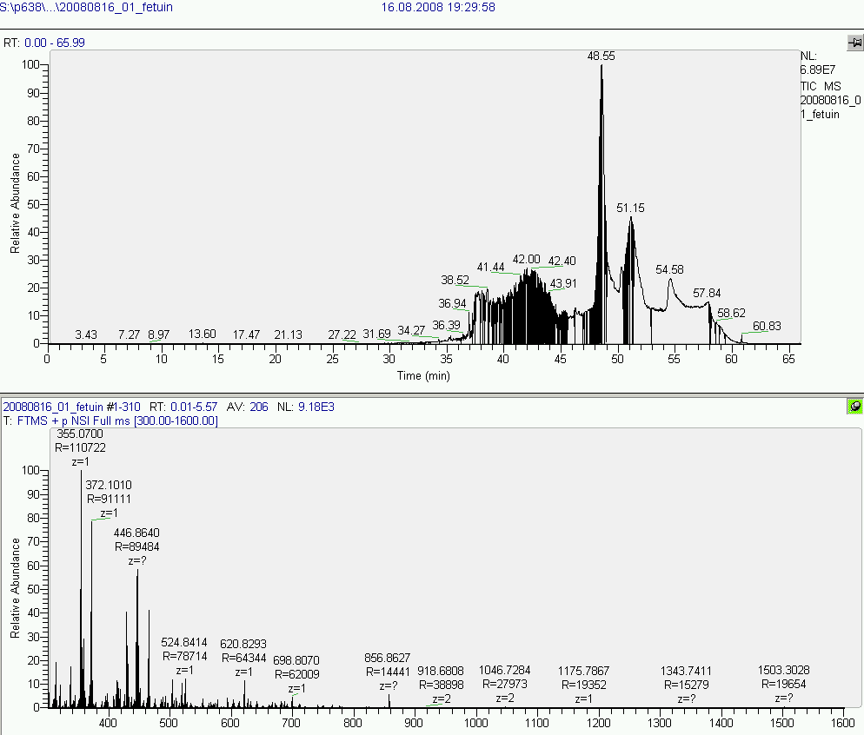
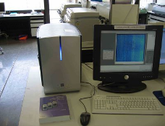
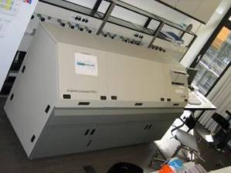
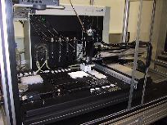
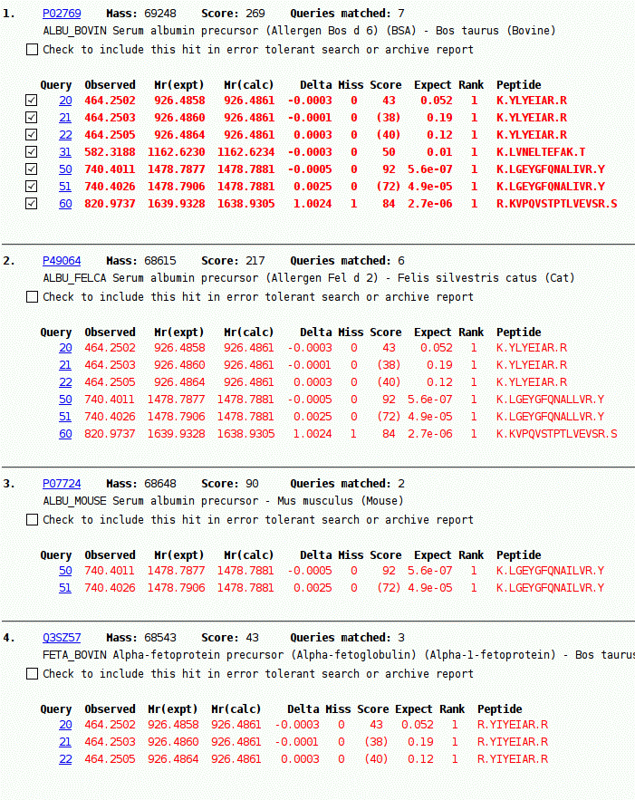
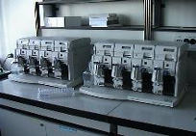
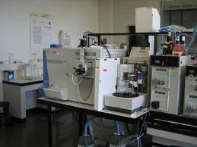
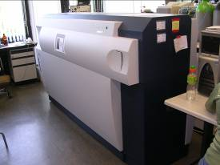
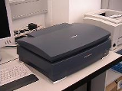
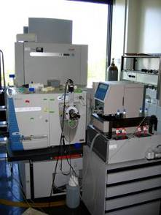
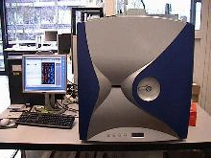
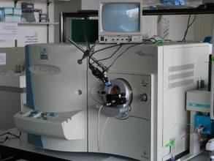
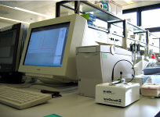
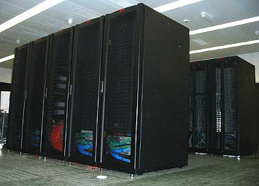
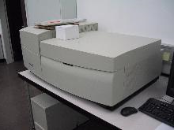
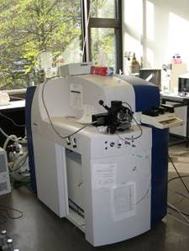
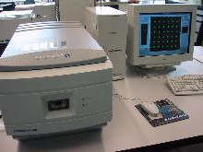
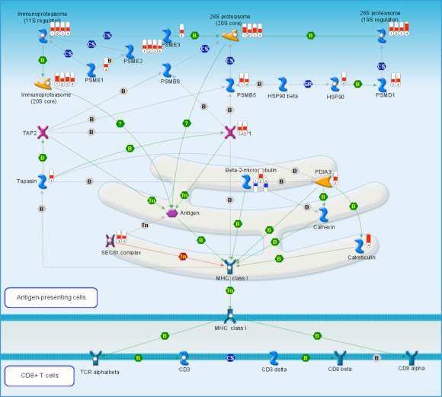
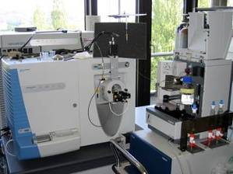
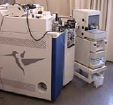
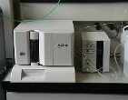
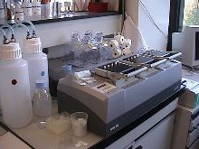
Motivation for Integrative Data Management
Peak List
Filtering
Observation
  data lies around: huge volumes, often unstructured, inherently distributed, usually file-based
  heterogeneous systems
  applications with no or poor interfaces
  no or weak interaction within instruments/applications
  processes shredded in scripts & command line tools
Consequences
  no reuse of research results
  no reproducibility/tracking of research
  no semantic search
  no data quality assurance
Required
  Data management system linking together all relevant data and applications
Filtered Peak List
Peptide Assignment
Protein inference
Protein Hits
Quantitative Analysis
Protein Concentration Log Ratio
Pathway Analysis
Flux Regulation

Slide 14
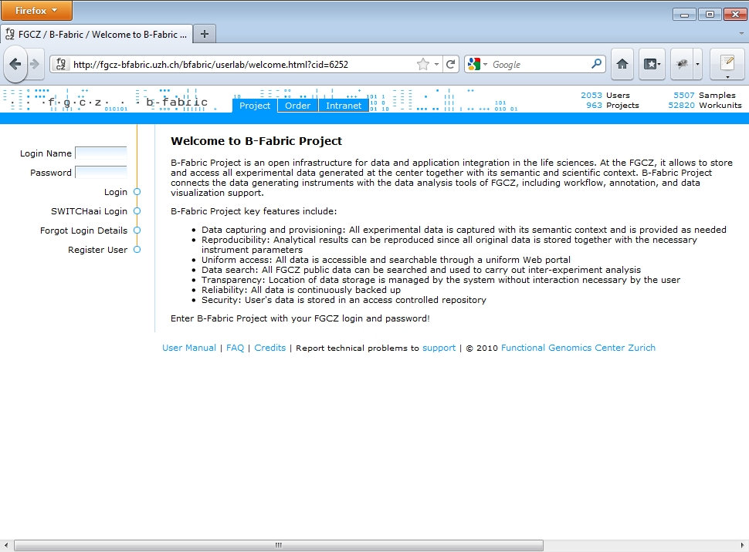


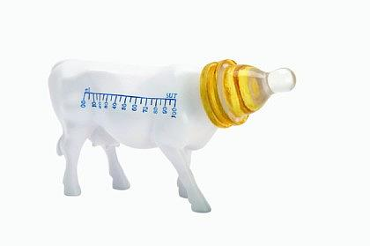
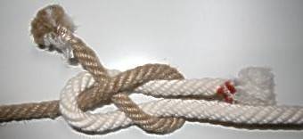
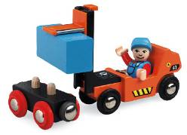
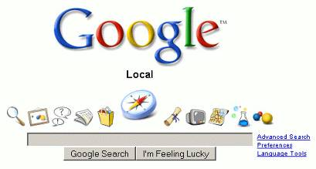
B-Fabric - The FGCZ Approach to Project and Data Management
User
Management
Project Life Cycle
Management
Secure Transparent
Data Storage
Data Capture
and Annotation
Data Curation
Unified Web-based
Data Access/Provision
Ad-hoc Transparent
Information Retrieval
Run/Feed External
Applications

Slide 15
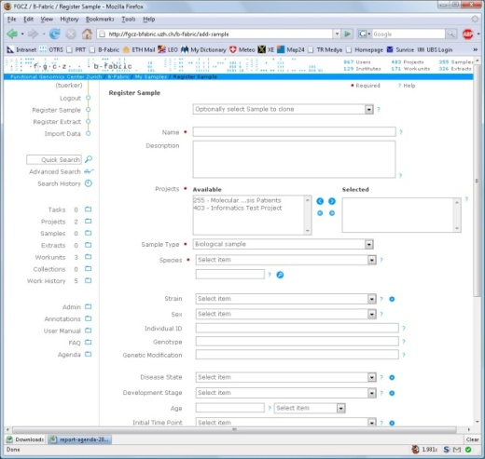
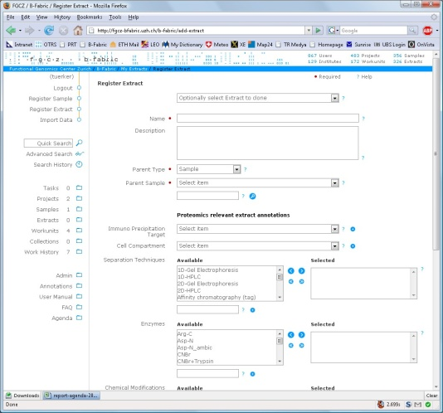
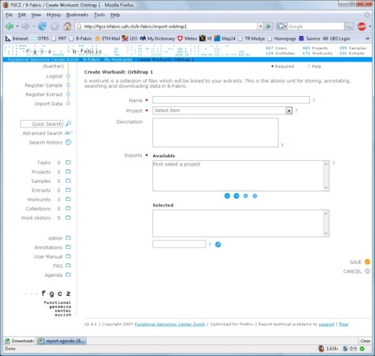
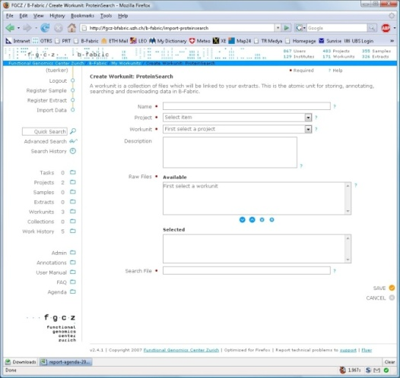
B-Fabric Philosophy: Be generic enough to capture any relevant data
Sample/Extract
Preparation
Data Reduction /
Conversion
“Database“ Search
Mass Spectrometry
Search Preparation
Register
Sample
Register
Extract
Create Workunit:
Orbitrap Experiment
Create Workunit:
ProteinSearch

Slide 16
B-Fabric History

Slide 17
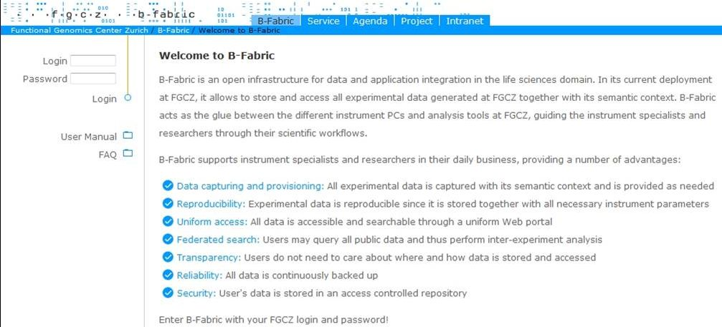
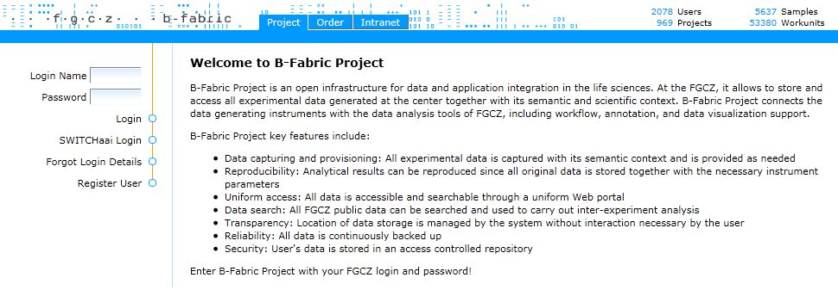
B-Fabric: What has changed?
Externally
  At first sight not much!
  Major Issue: Integration of B-Fabric with Project Request
  Revised organization of data
  Some new features
Internally
  completely new based on new technologies
  code reengineered
Main advantage: Single integrated tool!
OLD
NEW

Slide 18
Old B-Fabric: Different Tools on Different Technologies
Project Request
Web Portal
(Smarty)
B-Fabric
Web Portal
(Cocoon)
PHP ↔ Perl
PHP ↔ SQL
Java↔ SQL
Active
Directory
sync
Database
Data Repository
(File System)
Project Request
PHP (Application Programming)
Smarty (Web Application Development)
PostgreSQL (Database)
B-Fabric
Java (Application Programming)
Apache Cocoon (Web Application Development)
PostgreSQL (Database)
Apache OJB (Object-Relational Mapping)
OS Workflow (Workflow Management)
Apache Lucene (Full-Text Search)
Apache log4j (Logging)

Slide 19
New B-Fabric: Integrated & Migrated to SEAM
B-Fabric
Web Portal
(SEAM)
Java↔ SQL
Active
Directory
sync
Database
Data Repository
(File System)
New B-Fabric
Java (Application Programming)
SEAM (Web Application Development)
Hibernate (Object-Relational Mapping)
PostgreSQL (Database)
jBPM (Workflow Management)
Apache Lucene (Full-Text Search)
Apache log4j (Logging)

Slide 20

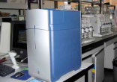
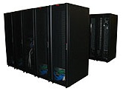
A little deeper look into the B-Fabric Architecture
External
Data Repositories
Instrument PCs
Affymetrix GeneChip
ABI MALDI TOF/TOF
LTQ-Orbitrap
External
Data Repositories
Computing
Clusters
Sun Grid Engine
User PCs
Data Evaluation
External
Data Repositories
Workhorses
Messaging
Copier
Indexer
Searcher
Grid Engine Worker
Frontend
Web Portal
Workflow
Messaging
Logging
B-Fabric
Database
Agilent QCReport
Internal
Data Repository
ANOVA Analysis
B-Fabric
Registered
Applications
AffymetrixImport

Slide 21
B-Fabric Project
Functionality
Submit/Review/Coach Projects
Manage Project Members
Import/Annotate Data Files
One-click Access to “My” Data
Browse Data Network
Quick/Advanced Search
Export/Download Data
Create/Run External Applications
Manage Annotations
Goals
  Reduce Time/Costs for Projects Application/Management
  Track Entire Project Life Cycle
Capture/Manage/Provide Data
Allow Access-controlled Data Sharing
Plug-in and provide new services/functionality
Generate Reports

Slide 22
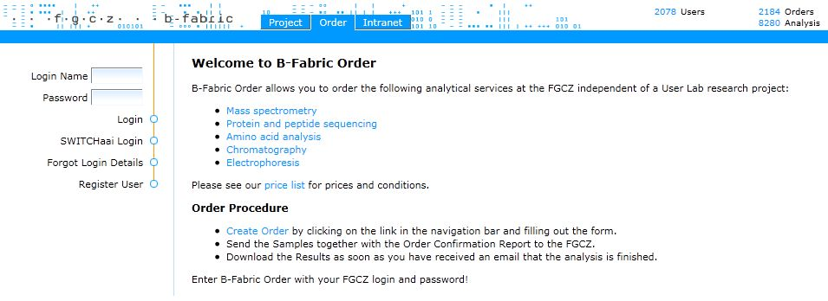
B-Fabric Order
Functionality
Edit Orders
Upload Sequence Files
Browse Orders
Upload/Download Results
Invoice Orders
Goals
Ease Ordering/Managing FGCZ services
Track Entire Order Management Process (Communication, Results, Invoices etc.)
Reduce Time/Costs for Order Management
Improve Support and Automate FGCZ Services
Generate Reports

Slide 23
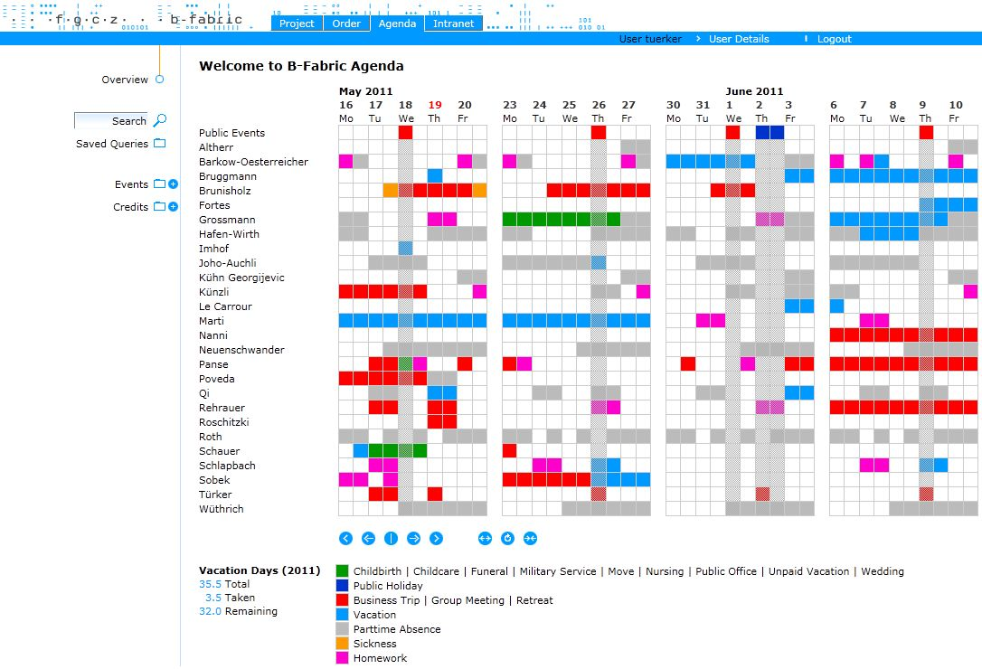
B-Fabric Agenda
Functionality
Edit Events/Vacation Credits
Browse Events/Vacation Credits
Overview Events
Generate Reports
Goals
Managing Employee Absences
Managing Vacation Credits
Vacation Calculation/Reporting
Adjustable Events Overview
AAAAA AAAAAAA
BBBBB BBBBBBB
CCCCC CCCCCCC
DDDD DDDDDD
EEEE EEEEEEEE
FFFF FFFFFFFFF
GGGG GGGGGG
HHHHH HHHHHH
IIIIII IIIIIIIIIIII
JJJJJJJJ JJJJJJJJJJ
KKKKKKK KKKK
LLLLL LLLLLLLLLL
QQQQ QQQQQQ
WWWW WWWW
EEEEEE EEEEEE
RRRR RRRRRRRR
TTTTTT TTTTTTTT
ZZZZZZ ZZZZZ
UUUUUUU UUUU
OOOO OOOOO
PPPPP PPPPPP
AAAAAA AAAAA
SSSS SSSSSSS
VVVVV VVVVVVV
BBBBBB BBBBBBB
NNNNN NNNN
MMMM MMMM
XXXXX XXXXXXX
YYYYYY YYYYYY
AAA
BBB
CCC

Slide 24
B-Fabric Common Features
Functionality
Managing user contact details
Browsing mails
Merging/cleaning duplicates and unassigned objects
Sending messages to selected users
Order key to physically access the FGCZ lab
Goals
Transparent login generation
FGCZ-wide password management (automatic password push to relevant FGCZ services)
Event-driven email notifications
Task management

Slide 25
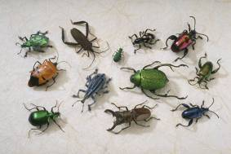

B-Fabric Deployment@ FGCZ: Some Current Facts
Users | 78
Institutes | 378
Organizations | 97
Orders | 2188
Projects | 969
Extracts | 7197
Workunits | 53379
Resources | 81103
Sample
biological source
Extract
0..1
0..*
0..*
0..*
0..1
Project
May 2011
experiment source
0..*
0..*
0..*
Application
produces
Workunit
comprises
Data
Resource
0..*
0..*
1..*
1..*
0..*
0..*
input

Slide 26
B-Fabric
Managing Users, Projects, Orders
Can Türker, Fuat Akal
Functional Genomics Center Zurich, Switzerland

Slide 27
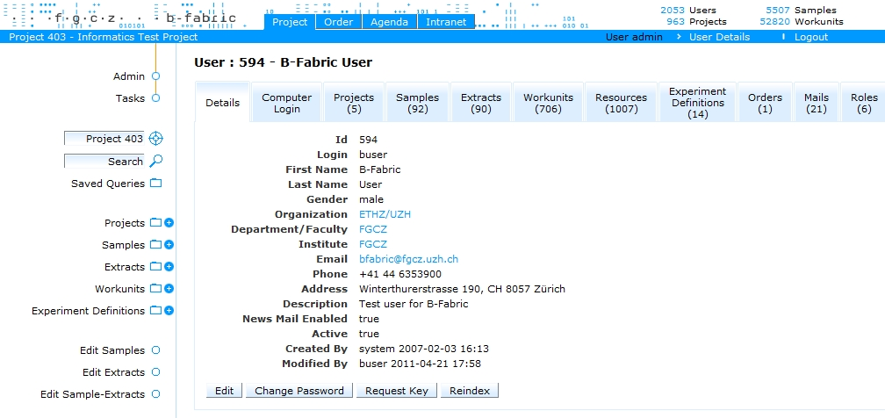
User Management
Registration
LDAP Sync
Role Mgmt.
Password Change
Door Key Request
Duplicate Merge
Mail Archive

Slide 28
Project Management
Application
Reviewing
Communication
State Tracking
Member Mgmt.
Data Mgmt.
Reporting
project request
pending
coach vote
reviewer vote
review
final decision
reject
accept
alter
members
running
rejected
finish
finished
publish
closed

Slide 29


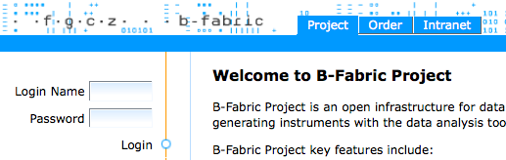


Project Management (Demonstration)
BCoordinator
DemoUser
Request
Project
Notify
Add New
Member
Final Accept
Comment
Back
Notify
Assign Coach
Notify
Add Review
Add Comment
Notify
BUser
Tuerker

Slide 30
Project Management Demo
Employee | User
Login as bcoordinator | Login as demouser
 | Request project
Assign coach: tuerker
Log out and log in tuerker
Add comment:???
 | Read e-mail
 | Check comment and respond
Read e-mail
AddReview
Log out and log in as bcoordinator
Final accept
 | Add new member: buser

Slide 31
Order Management
Submission
Communication
State Tracking
Result Provision
Charging
Booking
create order
pending
submit
upload sequence file
submitted
order/samples
processable
yes
no
accepted
rejected
start processing
add analysis results,
charge analysis
processing
all items processed
finished
all items booked
closed

Slide 32

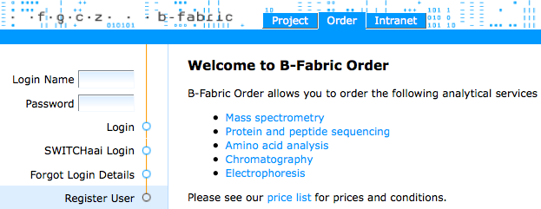
Order Management (Demonstration)
Functional Genomics Center Zürich
FGCZ
Send Signed Form & Samples
By post
Download Result
Finish
Notify
View & Sign
Confirmation Form
Process
BEmployee
Add Results
BUser
Create & Submit
Order
Charge
Add Comment:
Attach File
Invoice & Close
Add Comment:
Missing Seq. File
Notify
Accept
Notify
Akal

Slide 33
Order Management Demo
User | Employee
Login as buser | Login as akal
Create order with two items
Submit order
View order confirmation form
Send samples + signed form
 | Show tasks: Accept Order
 | Add comment: Missing sequence file
Read e-mail
Add comment: Attach the sequence file
 | Read e-mail
 | Accept order and logout
 | Login as bemployee
 | Process order
Refresh order and check status
 | Add result file
 | Charge items
 | Finish Order
Download result
 | Create Booking
 | Close Order
Pay the bill

Slide 34
B-Fabric
Analyzing Data
Hubert Rehrauer, Christian Panse
Functional Genomics Center Zurich, Switzerland

Slide 35
Dataflow Diagram
Computing Cluster managed by Sun Grid Engine
App
App
App
App
App
App
App
App
Mass-Spec
Affymetrix
Arrays
Staging
disks
Raw Data Archive
Analysis
Results
Agilent
Arrays
454
NGS
B-Fabric Web Portal
Sample Management
Data Management
Data Processing
Data Distribution
Samples
Data links
Results
SOLID
NGS
Notes:
many instruments
Staging in order to instantly free instrument computers and run preprocessing
Instrument data transfer:
- ssh
Staging – archive transfer
- nfs
really big storage
b-fabric to track the samples
data analysis software: grabs the data

Slide 36
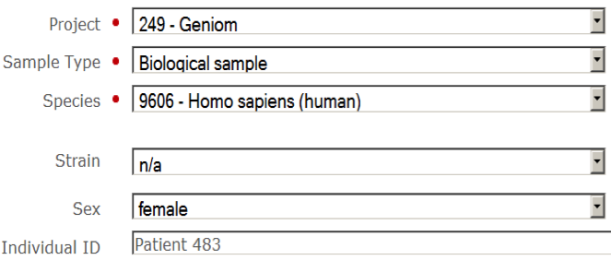
Sample Management and Data Analysis
B-Fabric
User-driven
Automated
Web-based
Analysis

Slide 37
From the Sample to the Result
Sample Registration
Hybridization
Data Transfer
Data Import
Experiment Definition
QC Report
Statistical Tests
Data Analysis

Slide 38
Sample Creation
Data model:
Raw
Data
Sample
Extract
Sample – Extract separation allows:
Raw
Data
Sample
RNA Extract
RNA Extract
for Rehyb
Raw
Data
Raw
Data
Protein Extract

Slide 39
Sample Creation Form

Slide 40
Extract Creation Form

Slide 41
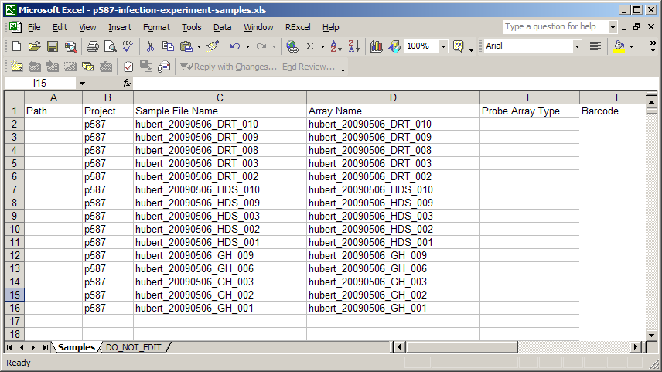
Hybridization
B-Fabric creates configuration file for the Affy station from the samples

Slide 42
B-Fabric Data Import

Slide 43
Experiment Definition
An experiment definition is a table specifying the data files and the sample parameters relevant for subsequent data analyses

Slide 44
Goals of our B-Fabric based Data Analysis
cover 90% of the analysis tasks
  implementing pipelines for the remaining cases would be inefficient
analysis workflows must be robust
  use only well established, widely applicable analyses
analyses should be runnable by users
  sensible default parameters!
results should be standalone
  zip-file with explanatory html page and data in Excel format

Slide 45
B-Fabric Data Analysis Workflows
Microarray
  Automated quality control
  Differentially expressed genes
  Affected GO categories and pathways
  …
Next-Generation Sequencing (NGS)
  Read processing
  Read mapping
  Read & coverage visualization
  RNA-seq: Differentially expressed genes
  …
Proteomics
  Peptide & protein identification
  Protein quantification
  Post-translational modifications
  …

Slide 46
Data analysis
Analyses take experiment definitions as input
Analyses for microarray data are R/Bioconductor based
Analysis output is HTML report with link to result files

Slide 47
Example: Inflammation Response Study
Trigger inflammation with two compounds:
  DRT
  GH
Compare response to negative control
  HDS
Run microarray experiments with 5 replicates for each condition
B-Fabric analyses:
  Affymetrix QC Report
  Two-Group Analysis: Differentially expressed genes between DRT and GH

Slide 48
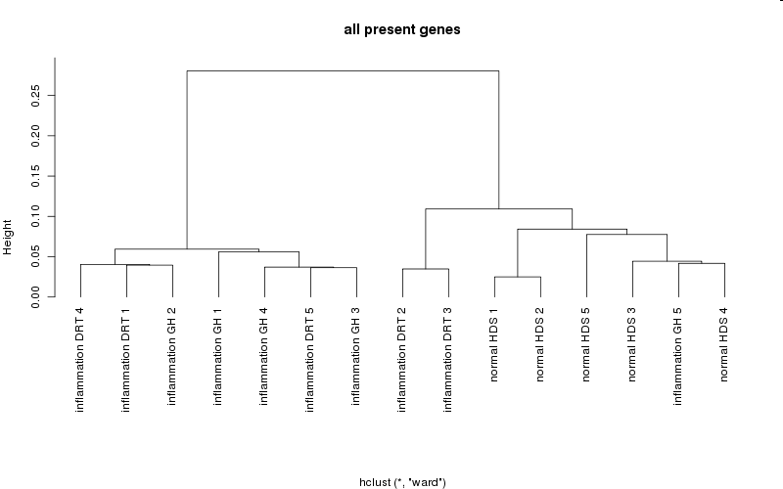
QC Report: Sample Clustering

Slide 49
Differential Expression Analysis
Comparing the treatments: DRT and GH
 | All replicates | Without Outliers
#probes with p<0.01 | 102 | 258
#genes with p<0.01 | 90 | 209
FDR | 0.98 | 0.84
GO categories | -- | inflammation (p=7e-06) cell cycle (p=7e-05)
Pathways | -- | TREM1 signaling (p=4e-05) …

Slide 50
B-Fabric for Switzerland
Generalizing B-Fabric towards an Infrastructure for Collaborative Research in Switzerland
Fuat Akal
Functional Genomics Center Zurich, Switzerland

Slide 51
Part - I
Authentication in B-Fabric via SwitchAAI/Shibboleth

Slide 52

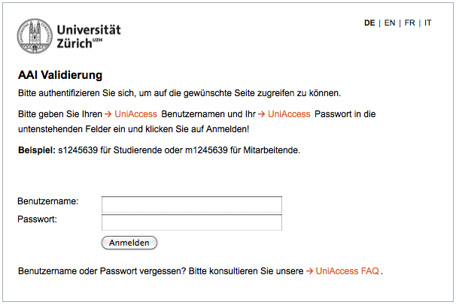
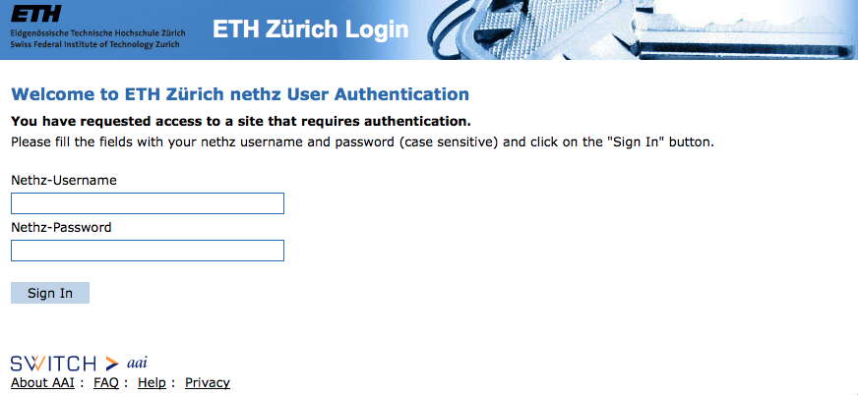
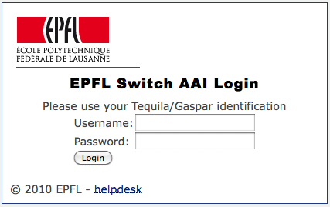

Authentication in B-Fabric via SwitchAAI/Shibboleth - I
SwitchAAI simplifies inter-organizational access to web resources via a single login
  It is deployed by most Swiss universities: http://www.switch.ch/aai/
If you ever came across one of the pages below, you must have used Shibboleth already
To facilitate collaboration among scientists, B-Fabric employs a dual login mechanism
  Both local B-Fabric and SwitchAAI/Shibboleth accounts work!

Slide 53
Authentication in B-Fabric via SwitchAAI/Shibboleth - II
Benefits
  Shibboleth users will implicitly become a part of the B-Fabric community
  Shibboleth users will not have to remember an additional login and password
  Shibboleth users may access several B- Fabric instances --possibly managed by different institutions-- with the same login and password and thus increase the potential for collaboration
Why there are still local B-Fabric accounts?
  Metadata about user provided by identity providers is not complete enough to use all B-Fabric services
    Detailed address information is required for project requests, service billing
  There are users that do not have Shibboleth accounts
    Academic users from other countries or external customers from companies

Slide 54

B-Fabric Login Process with a SwitchAAI/Shibboleth Account (Demonstration)
Login to B-Fabric
with a
Shibboleth Account
Shibboleth accounts must have been mapped
to local B-Fabric accounts to perform login.
Is the Shibboleth account
mapped to a
B-Fabric account?
Is there a
B-Fabric account
with this e-mail?
User has a
B-Fabric account
with another e-mail?
User wants a
B-Fabric account?
No
Yes
Map the Shibboleth
account to this B-Fabric
account automatically
Let the user map
herself to her B-Fabric
account manually
Let the user create
a B-Fabric account
and map it
Authenticate
Authorize
Authorize as the
Mapped B-Fabric User
Authorize
as Guest

Slide 55
Part - II
Ad-hoc Coupling of External Data Stores

Slide 56
Ad-Hoc Coupling of External Data Resources
Importing data from external data stores are performed by using applications
Two types of data import
  Link import
    Files are just linked to B-Fabric and still reside on the external store
    Consistency and maintenance of the files are the external store’s responsibility
  Physical file import
    Files are physically copied to a target repository
    Target repository can be any data storage accessible to B-Fabric
    FGCZ only considers its data servers as secure, reliable and long-term storages

Slide 57


Ad-Hoc Coupling of External Data Resources (Demonstration)
Sun Grid
Engine
(SGE)
External
Data Store X
Scientist 2
External
Data Store Y
Scientist 1
Access
Data
Execute
linkImport
From X
Execute
remoteFileImport
From Y
Access
SGE
Place
a link
Access
Data
Copy
data
B-Fabric
B-Fabric
Database
remoteFileImport
EAWAG_remote_file_import
linkImport
EAWAG_link_import
…
Fgcz-data Server
(secure, reliable, long-term)
B-Fabric Repository
Registered Applications
FGCZ

Slide 58
B-Fabric
Wrap-Up and Outlook
Can Türker
Functional Genomics Center Zurich, Switzerland

Slide 59
Wrap-Up: B-Fabric Benefits
Secure, long-term data storage
Easy web-based data access
Fast access to relevant data
Data reuse
Reduced annotation work through automatic export to external marts
Access-controlled data sharing
Increased data quality
Generation of reports etc.
Reproducibility of research results
Transparent management of users, projects, orders, …
Ad-hoc addition of new services
Task management (user guidance)
Charging and Invoicing
Tracking centers resources/capacities
Central administration tasks automated (user registration/synchronization, door key request, …)
Reduced IT admin, scientists, secretary work
Improved service support/quality

Slide 60
Outlook
Further developing of B-Fabric
Management module for User Lab services (tracking, invoicing, …)
Implement Web Services API (especially for data export/import)

Slide 61
How research centers/groups can benefit from B-Fabric?
Request and run a project at FGCZ
Have your own B-Fabric deployment: How?
  Download B-Fabric, customize and run it!
    www.bfabric.org
    Requires a programmer to maintain and customize the system for specific needs
  Rent an individual B-Fabric instance hosted elsewhere
    Elsewhere could be «Informatikdienste» or FGCZ
    Service and price model to be developed
B-Fabric for Professors
  To manage their PhD Students
  PhD Students get their computer accounts with no need to go to the admin
  PhD Students import and share all their relevant documents and data
  Research becomes better documented and traceable
  Not only secondary but also primary research data gets archived

Slide 62




Many thanks to all people having contributed to the development, testing, using, and supporting B-Fabric
Developers
Fuat Akal
Christian Decker
Michael Fetzer
Felix Knecht (Otego)
Aleksander Markovic
Lukas Marti
Benedikt Thelen
Can Türker
Alumni Developers
David Altorfer
Dieter Joho
Haissam Mouhasseb
Giacomo Pati (Otego)
Further Contributors
Ralph Schlapbach
Etzard Stolte
FGCZ External Application Developers
Simon Barkow-Oesterreicher
Remy Bruggmann
Christian Panse
Weihong Qi
Hubert Rehrauer
Marco Schmidt
Sponsors
UZH / ETHZ (financiers of the FGCZ)
SWITCH: «Generalizing B-Fabric towards an Infrastructure for Collaborative Research in Switzerland» (June 2009-May 2011)
SYBIT: «Infrastructure for BATTLEX» (June 2010-December 2011)

Slide 63
Demo Materials
This presentation
  http://fgcz-intranet.uzh.ch/publish/website_documents/bfabric/2011-05-23-B-Fabric-Day.pptx
Screen Captures
  Project Management
    http://fgcz-intranet.uzh.ch/publish/website_documents/bfabric/bfabric_day_project_management_demo.mov
  Order Management
    http://fgcz-intranet.uzh.ch/publish/website_documents/bfabric/bfabric_day_order_management_demo.mov
  Shibboleth Login
    http://fgcz-intranet.uzh.ch/publish/website_documents/bfabric/bfabric_day_shibboleth_demo.mov

Slide 64
What’s next?

Slide 65
Backup Slides

Slide 66

Metadata Management
Observation:
  No data schema that satisfies all users
  Vocabularies are dynamically evolving
  Lack of data quality
Solution:
  Concise metadata schema
  „Drop-downs“ as much as possible
  Extensible vocabulary
  Vocabulary reviewing
Drop-downs
Extend vocabulary

Slide 67

Annotation Management
Reviewing/Releasing
Merging
Merge in case of synonyms
Drop-downs
Determine placement in
drop-down menus
Extend vocabulary
Release annotation

Slide 68



Application Coupling
Observation:
  No system can provide all needed application-specific functionality
  System developers becomes the bottleneck
  System changes require compilation and restart of the system
Solution:
  Framework with generic workflows to invoke external applications
  Ad-hoc coupling without compiling and restarting the system
  Automatic creation of application run buttons
All registered applications
External script (program) that will
be invoked within the workflow
With its configuation,
the application run button
will appear on all screens
containing the right inputs
With its configuation,
the application run button
will appear on the workunit creation screen
Select data sets that can be processed
properly by the external application

Slide 69



Data Import
Link Import:
  Files linked to B-Fabric
Physical File Import:
  Files copied to target repository and linked to B-Fabric
Data Import from Everywhere via Applications
All registered data import applications
Select & Assign Extract to Resource
Next Workflow Step:
Assign Extract Information
to Imported Resource
Depending on the configuration of the import application
and the choosen project, only the potentially relevant files are listed
Invoke the corresponding data import application

